Slide 1

PicPro Image Transformation Application
Matthias Eder (n11378093) and Eric Zhang(n10319191)
CAB432 Cloud Computing 2022
Queensland University of Technology

Slide 2
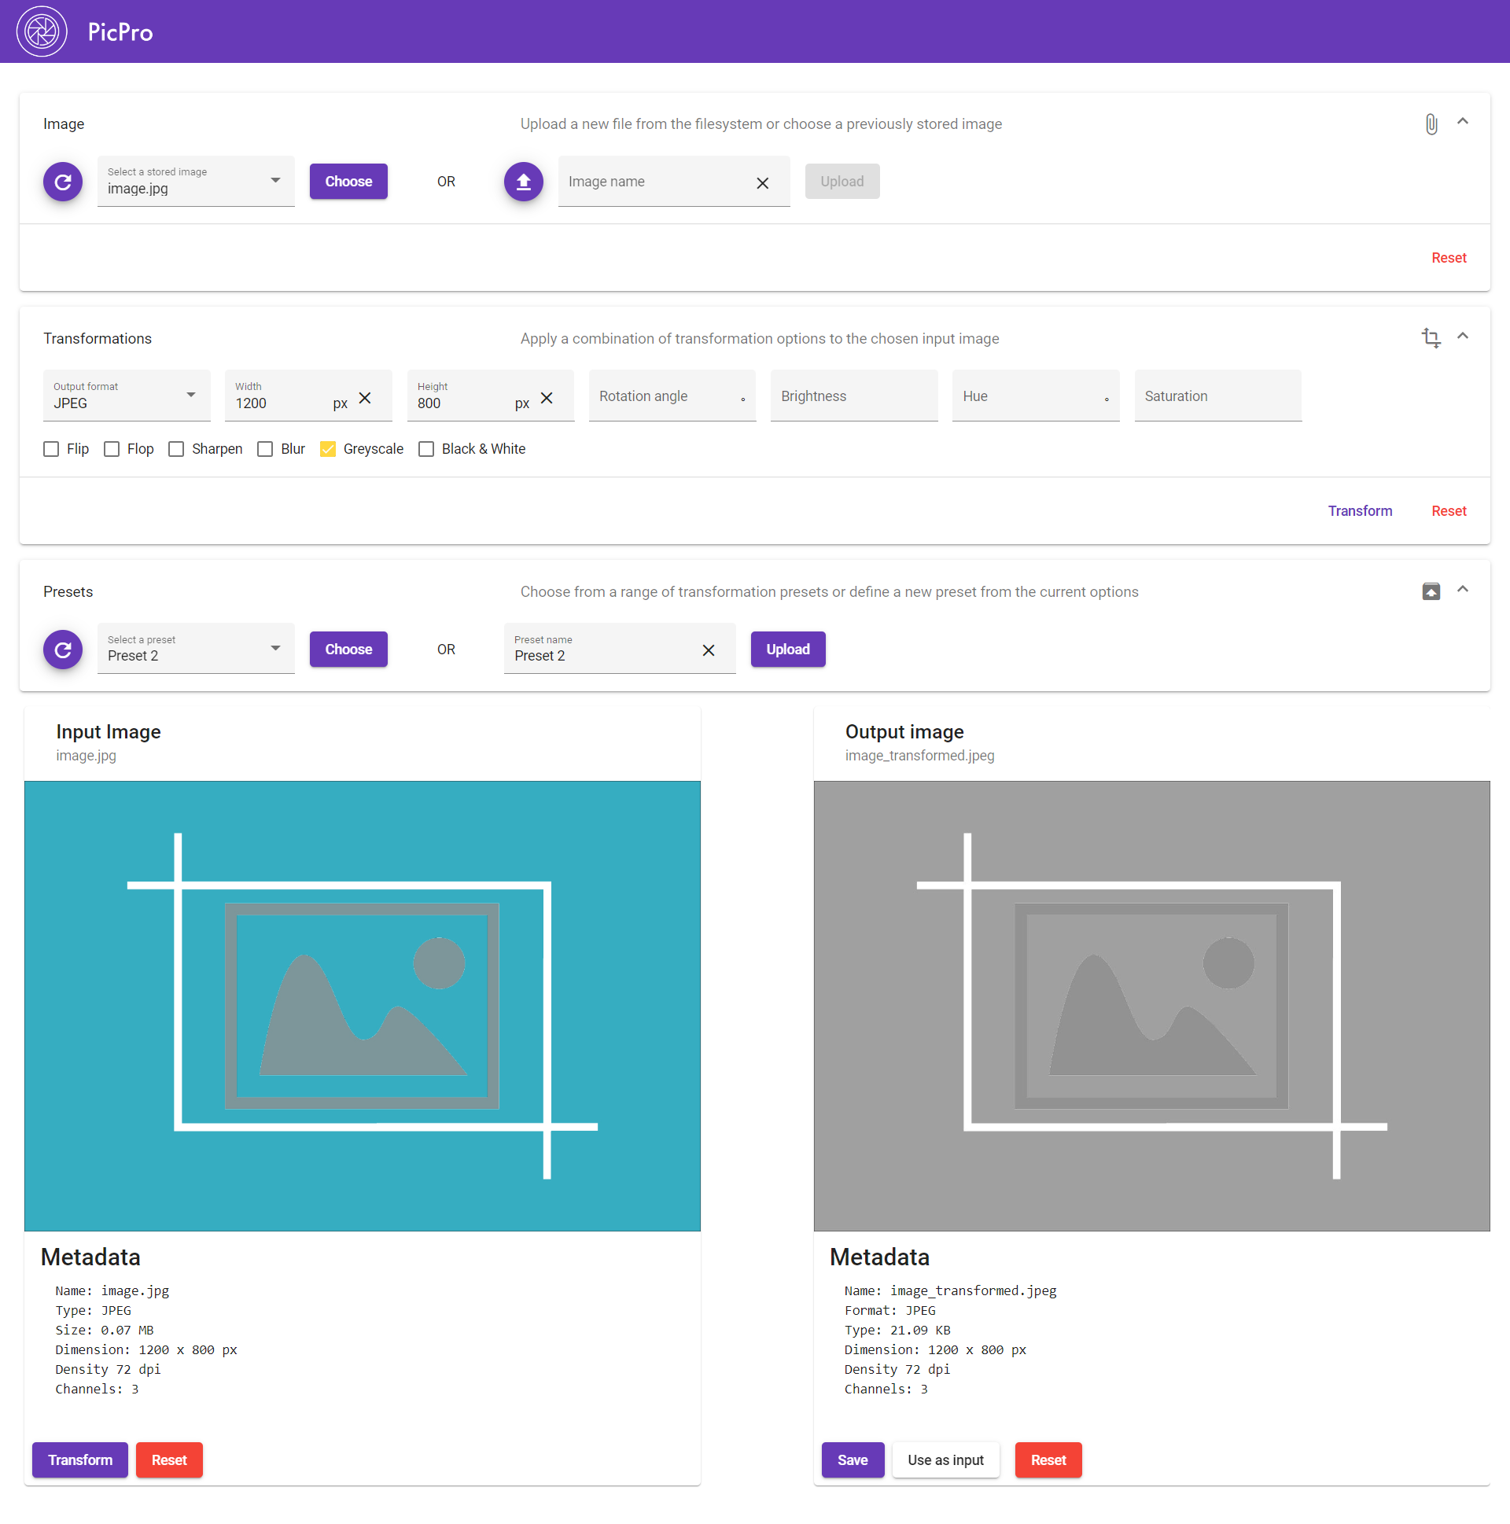
The App
Alter images by changing the filetype format, resizing the image, or adding effects like blur, greyscale, etc
Allows new and transformed images to be stored in S3 to be accessible at all times
Saves presets for transformations for users that wish to use the same transformation over multiple images

Slide 3
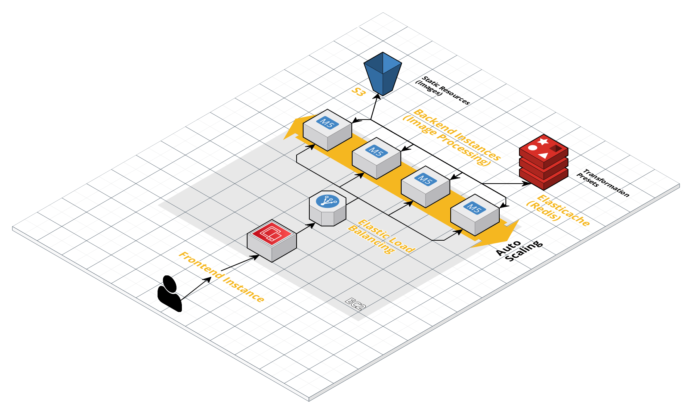
The Architecture
https://cloudcraft.co/

Slide 4
Architecture/Deployment
https://cloudcraft.co/

Slide 5
Scaling/Performance
To Be Replaced

